Slide 1
THE RISK MITIGATION PROCESS.
Presented by:Meenakshi Joy
032200300002022
Submitted to: Vikas Sir
Subject: CIS

Slide 2


Index
Introduction
Risks in ICS
Risk mitigation process
Benefits
References
Conclusion

Slide 3
INTRODUCTION
# In Industrial Control System (ICS) environment, the risk can also be in the form of safety risk (personal and organisational), operations risk , financial risk , environmental risk ( pollution, catastrophic incident such as fire explosion) and some other type of risk.
# Risk mitigation in industrial control systems (ICS) involves identifying potential threats and vulnerabilities and implementing strategies to minimize the impact and likelihood of adverse events.
# To mitigate these risks, organizations should conduct thorough risk assessments, implement robust cybersecurity measures, adopt best practices for physical security, and regularly update and monitor their industrial control systems.

Slide 4
RISKS IN ICS
Cybersecurity threats
-Malware and ransomware
-Unauthorised access
-DOS attacks
Physical threats
-Natural disaster
-Unauthorised physical attacks
Human factors
-Error
-Insider threats
-Improper maintenance

Slide 5
Regulatory and compliance risks
-Non compliance
-No regulations
Insufficient logging and monitoring
-Limited incidence response capability
Environmental risks
-Extreme weather conditions

Slide 6
RISK MITIGATION PROCESS
#The risk mitigation process in Industrial Control Systems (ICS) involves identifying, assessing, and managing risks to ensure the security, reliability, and safety of critical infrastructure.
1)Risk Identification
Consider all types of risks, including financial, operational, compliance, reputational, and environmental
2) Prioritize Risks
Prioritize risks based on their potential impact on system safety, reliability, and operational continuity.
3)Implement Risk Mitigation Strategies:
Develop strategies to mitigate each risk. There are four main strategies:
Avoidance: Eliminating the risk altogether.
Reduction: Minimizing the likelihood or impact of the risk.
Transfer: Transferring the risk
Acceptance: Accepting the risk and taking action to mitigate it.
Select the most appropriate risk mitigation strategy for each risk.
4) Containment and reporting.

Slide 7
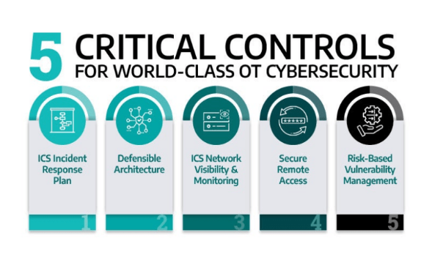

Slide 8
BENEFITS OF RISK MITIGATION
Reduced risk of cyberattacks and other threats.
Improved security posture of the ICS.
Increased reliability and availability of the system.
Enhanced compliance with regulatory requirements.
Reduced costs associated with security incidents and downtime.
Reduced risk of losses
Increased efficiency.

Slide 9
Conclusion
*The risk mitigation process in Industrial Control Systems (ICS) is an ongoing effort that requires continuous improvement and adaptation.
*Integration is crucial: Risk mitigation should be integrated throughout the entire ICS lifecycle, from design and development to operation and maintenance.
*Continuous assessment is vital: Regularly reassessing risks and adapting mitigation strategies is essential due to the ever-evolving threat landscape and changes in the operational environment.
*However, by effectively implementing this process, organizations can significantly reduce the likelihood and impact of cyberattacks and other threats, ensuring the safe, reliable, and efficient operation of their critical infrastructure.

Slide 10
References
1)https://www.isaca.org/resources/news-and-trends/isaca-now-blog/2023/common-cybersecurity-risks-to-ics-ot-systems
2)https://www.armis.com/ics-security-risk-assessment/
3)https://www.cisa.gov/topics/industrial-control-systems
4)https://www.dragos.com/industrial-cyber-risk-management/

Slide 11
THANK YOU:)

